Slide 1
MEASURING DISTANCE

Slide 3
Find the distance scale.

Slide 4
Hold the edge
of a piece
of paper
against points
A and B.
(scrap paper)

Slide 5
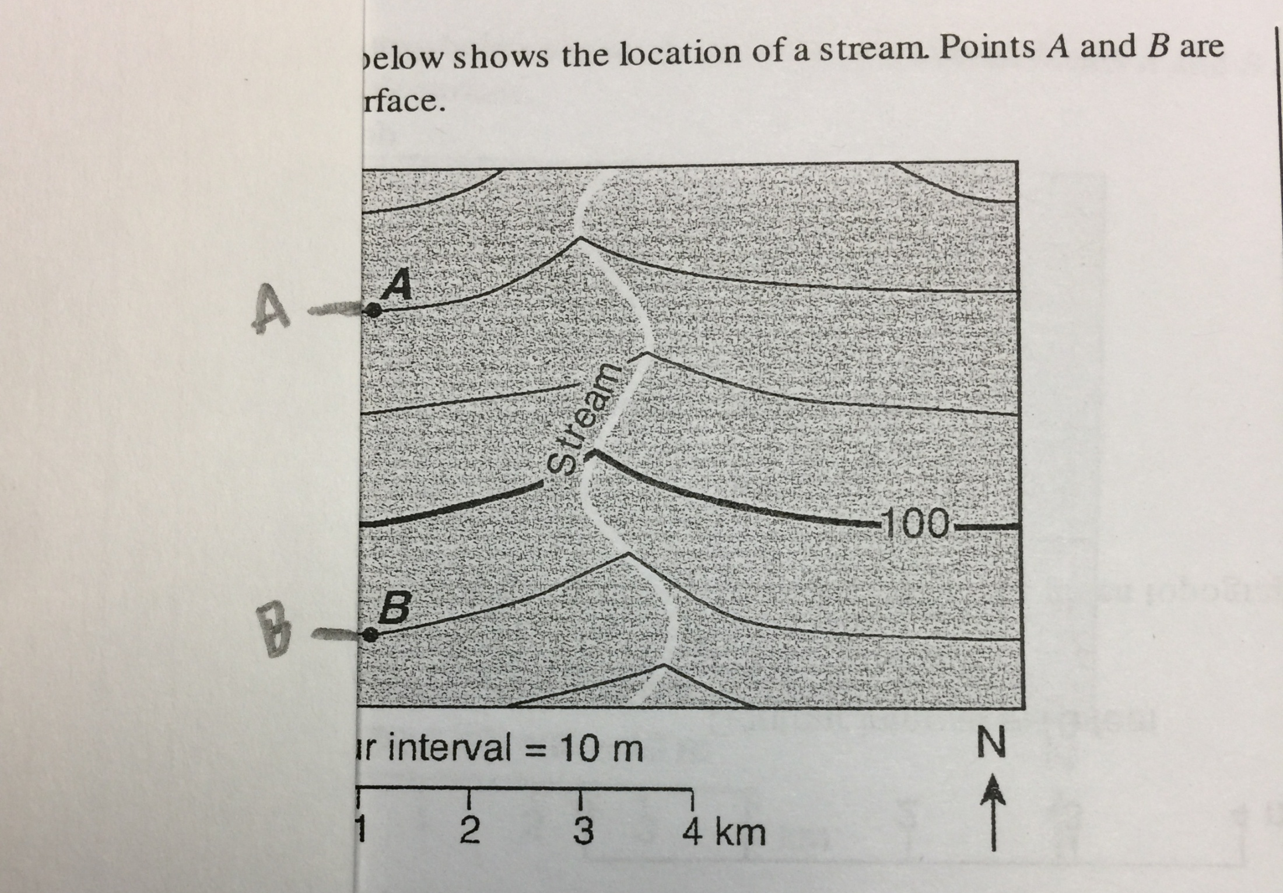
Make a small
dash mark
at each point.
Label the dashes,
if you want.

Slide 6
(I like to put the dashes on TOP of the scale so that I can see the numbers!)
• Bring the dash marks
to the distance scale.
• Line up one dash with zero.
• Read where the other dash is.
• (You may have to do
some estimating here.)

