Slide 1
CAPILLARY ACTION (CAPILLARITY)

Slide 2
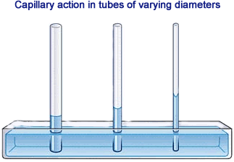

Slide 3
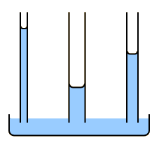

Slide 4
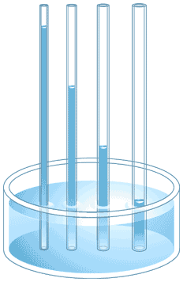

Slide 5
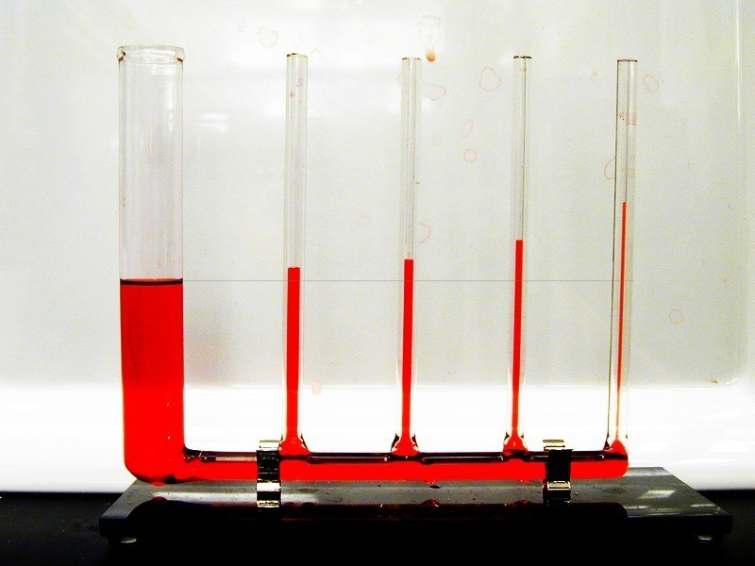

Slide 6
https://www.youtube.com/watch?v=7AU1SjYoB3A

Slide 8



